Slide 1
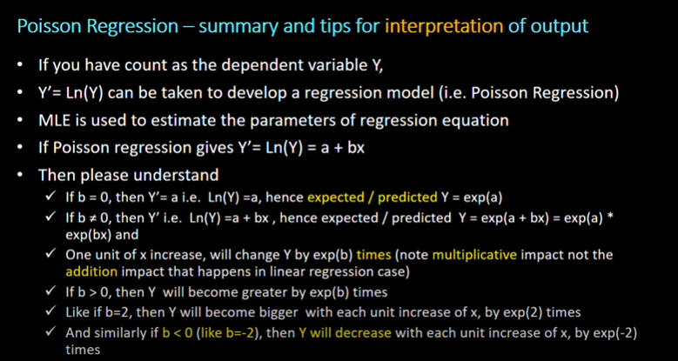

Slide 2
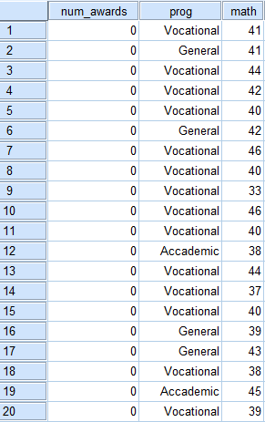
The number of awards earned by students at one high school. Predictors of the number of awards earned include the type of program in which the student was enrolled (e.g., vocational=3, general=1, and academic=2) and the score on their final exam in math.

Slide 3
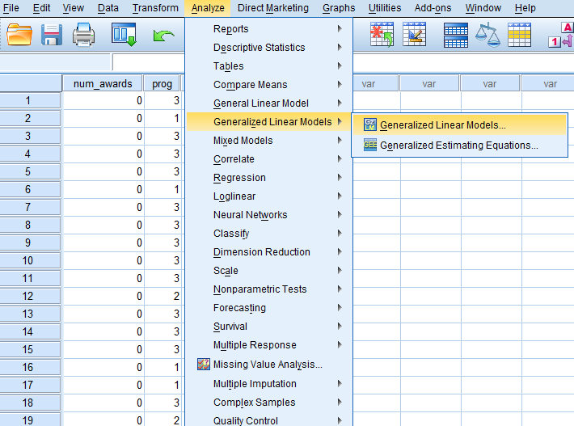

Slide 4
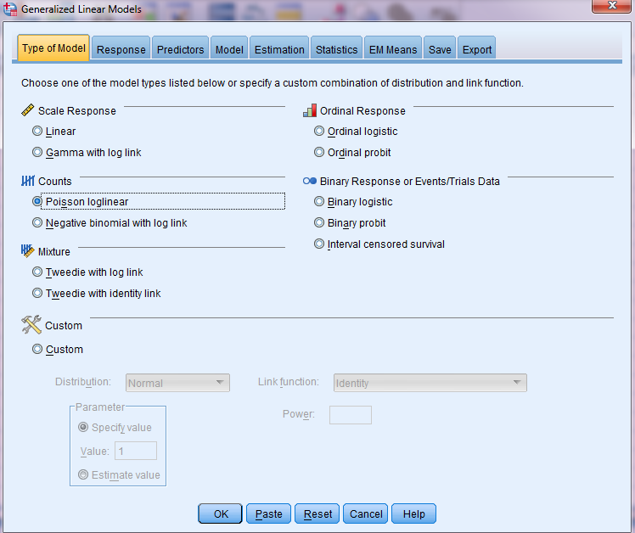

Slide 5
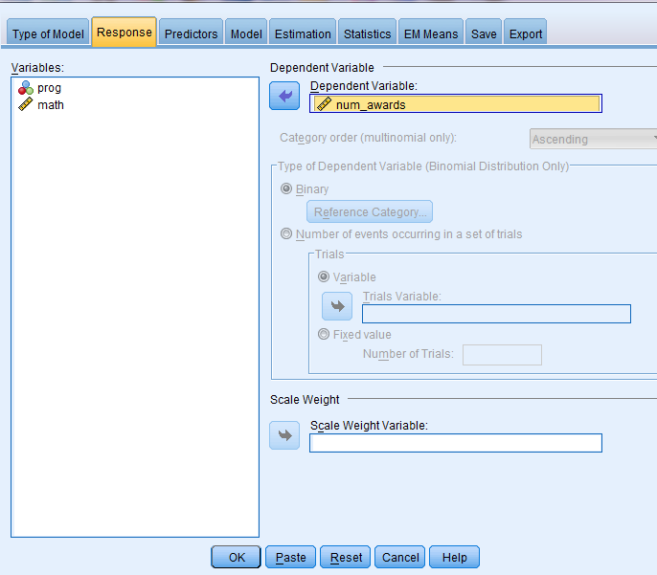

Slide 6


Slide 7
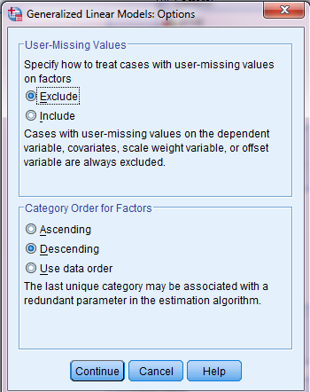
If you want to change reference category, click Option and change Ascending or Descending icon, then click continue.

Slide 8
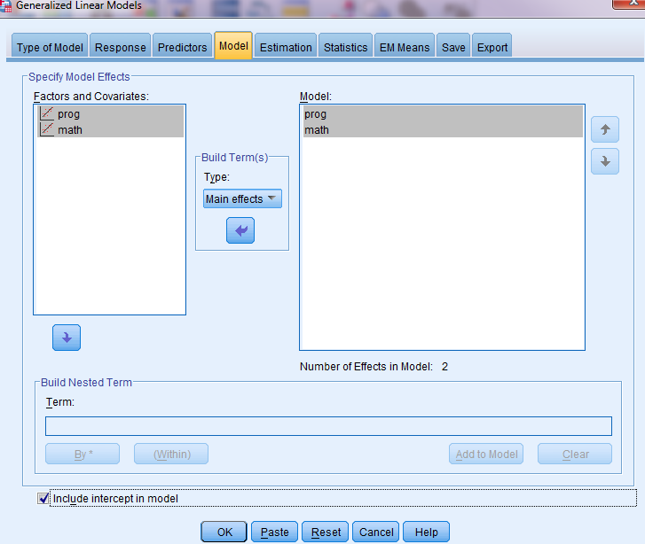

Slide 9
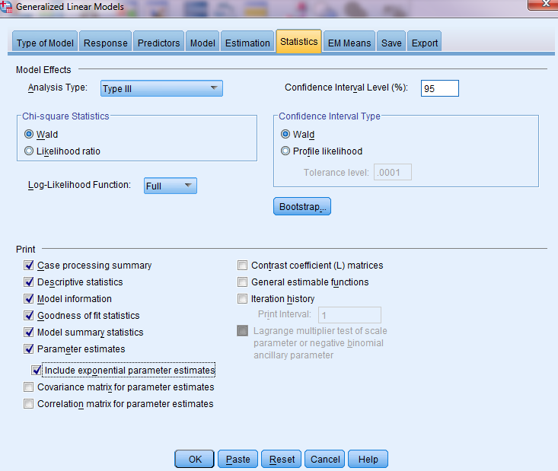

Slide 10
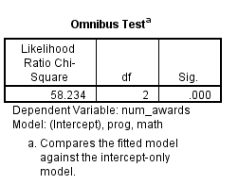


Slide 11
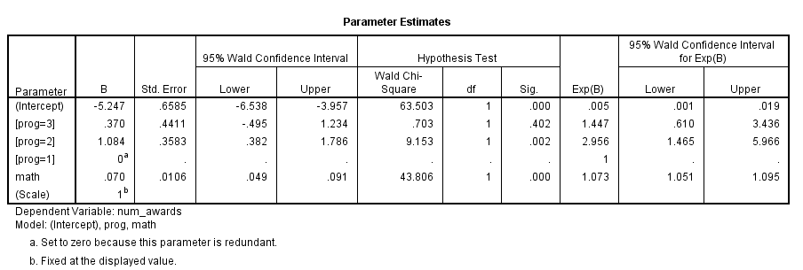
Score of math is a significant predictor of the number of awards earned by students (B=0.70, p<0.001). For one unit increase in math score, the predicted log counts of number of awards earned by students increased 0.07 times. The incidence rate ratio (IRR) indicates that for every one unit increase on the predictor (math score), the incidence rate (for number of award) increased by a factor of 1.073 (exp(0.07)) or (1.073-1)*100= 7.3%.

Slide 12
Program (Academic Vs General) is a significant predictor of the number of awards earned by students (B=1.08, p<0.01). The predicted log counts of number of awards earned for academic program, the incidence rate (the number of awards earned) was 2.956 times greater than that of general program. In other words, the IR for academic program was (2.95-1)*100=195% greater than that of general program.

